Slide 1

Constructors

Slide 2
Constructors
A constructor initializes an object immediately upon creation. It has the same name as the class in which it resides and is syntactically similar to a method.
Once defined, the constructor is automatically called immediately after the object is created, before the new operator completes.
Constructors have no return type, not even void.
the implicit return type of a class’ constructor is the class type itself.
the constructor’s job to initialize the internal state of an object so that the code creating an instance will have a fully initialized, usable object immediately.

Slide 3
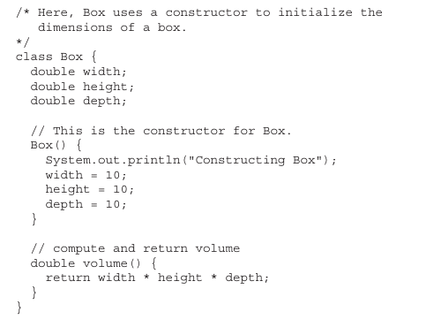

Slide 4
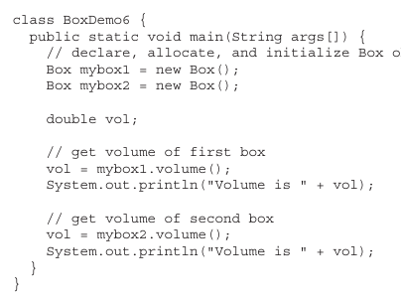

Slide 5
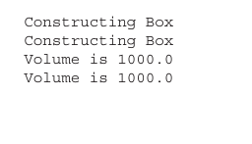
OUTPUT

Slide 6
Types of Constructors
Default Constructors
Parameterized Constructors

Slide 7
Default Constructors
When you do not explicitly define a constructor for a class, then Java creates a default constructor for the class.
The default constructor automatically initializes all instance variables to zero.
The default constructor is often sufficient for simple classes, but it usually won’t do for more sophisticated ones.
Once you define your own constructor, the default constructor is no longer used

Slide 8
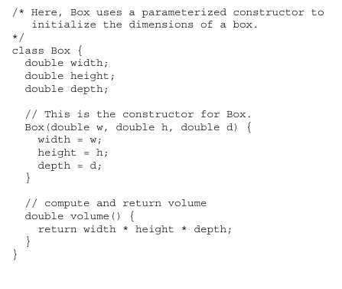
Parameterized Constructors

Slide 9
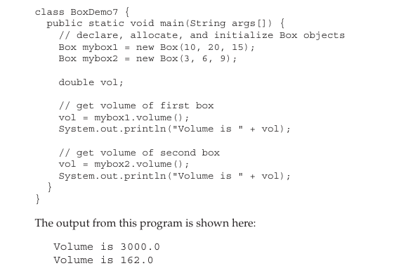

Slide 10
The This keyword
a method will need to refer to the object that invoked it.
To allow this, Java defines the this keyword. this can be used inside any method to refer to the current object.
That is, this is always a reference to the object on which the method was invoked. You can use this anywhere a reference to an object of the current class’ type is permitted.

Slide 11
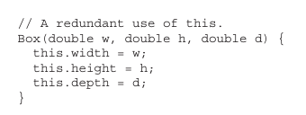

Slide 12
Method Overloading
In Java it is possible to define two or more methods within the same class that share the same name, as long as their parameter declarations are different.
The methods are said to be overloaded,and the process is referred to as method overloading.
Method overloading is one of the ways that Java supports polymorphism.
When an overloaded method is invoked,Java uses the type and/or number of arguments as its guide to determine which version of the overloaded method to actually call.
overloaded methods must differ in the type and/or number of their parameters.
When Java encounters a call to an overloaded method,its imply executes the version of the method whose parameters match the arguments used in the call.

Slide 13
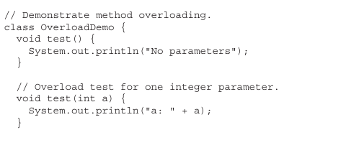
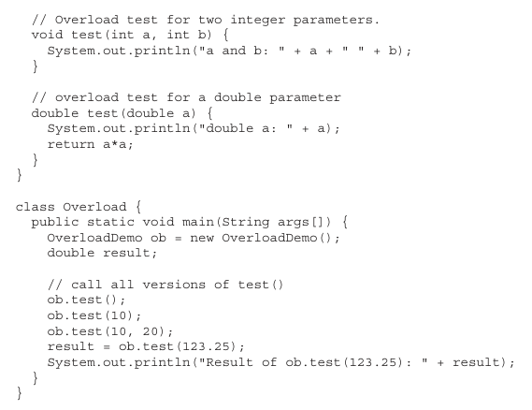

Slide 14
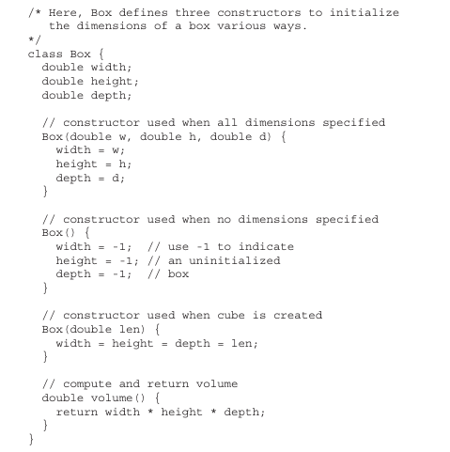

Slide 15
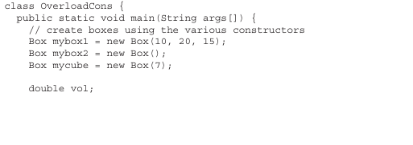
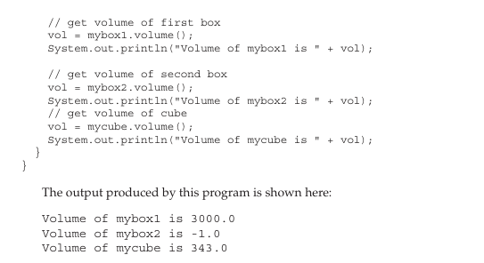

Slide 16
The End

